Slide 1
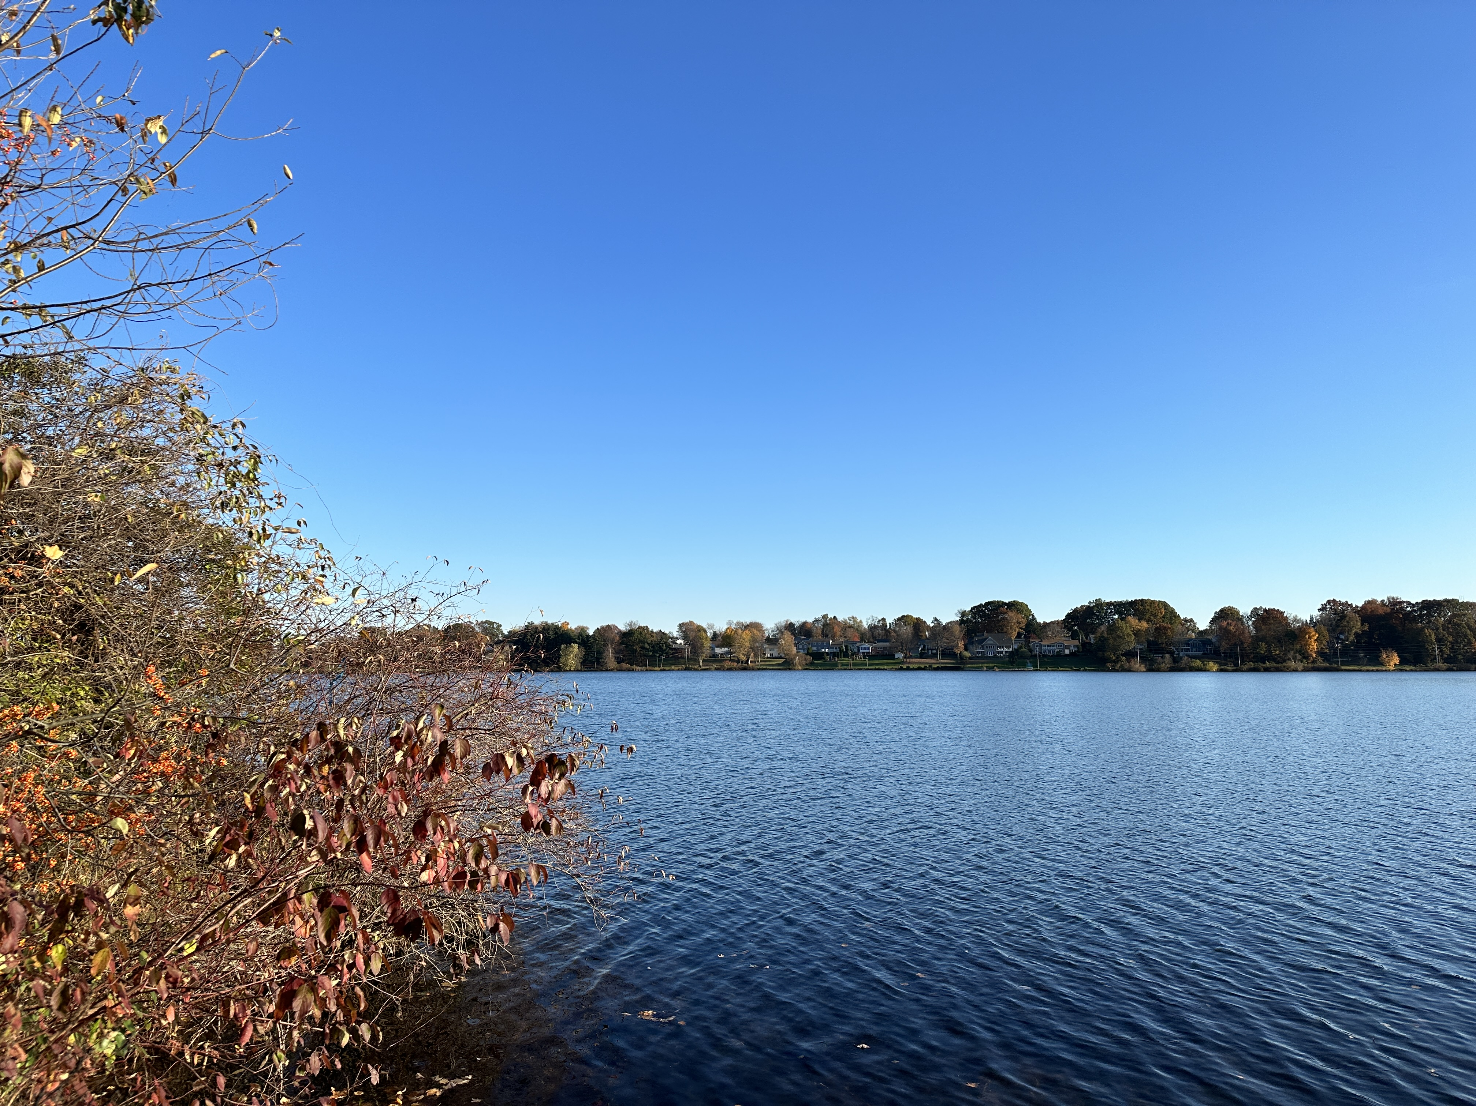

Batterson Park Subcommittee Meeting
March 3, 2025

Slide 2
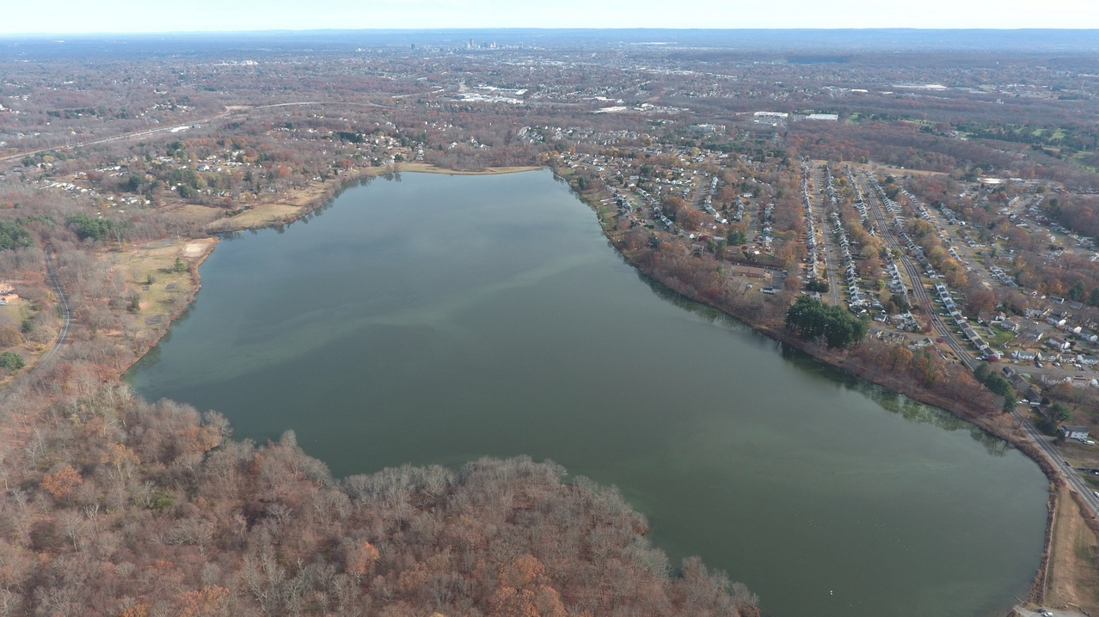
Photo credit: Johnny Dawson, November 2024

Slide 3
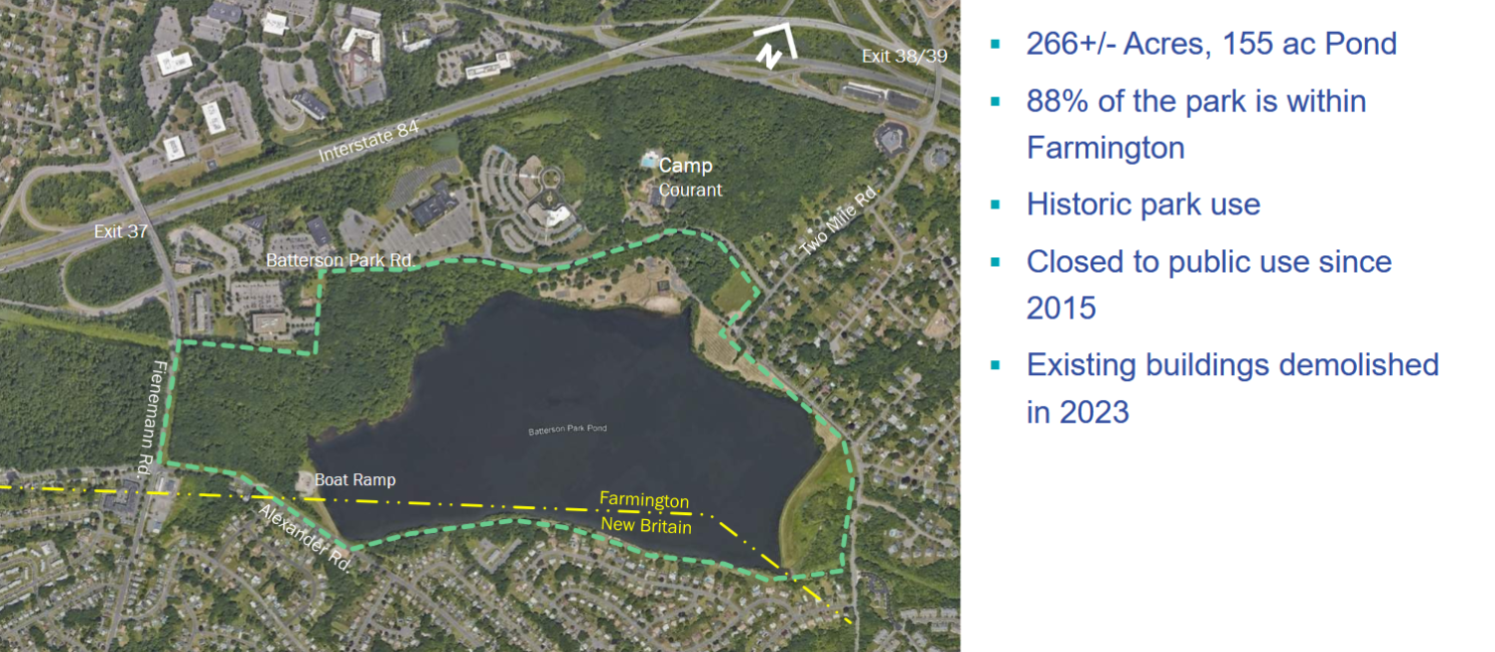

Slide 4
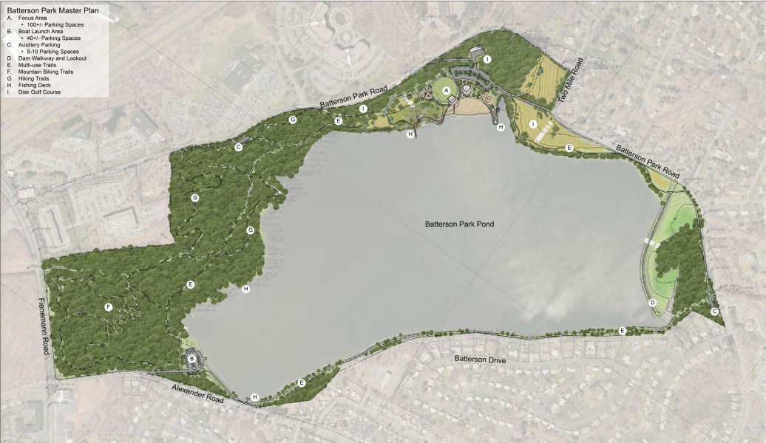

Slide 5
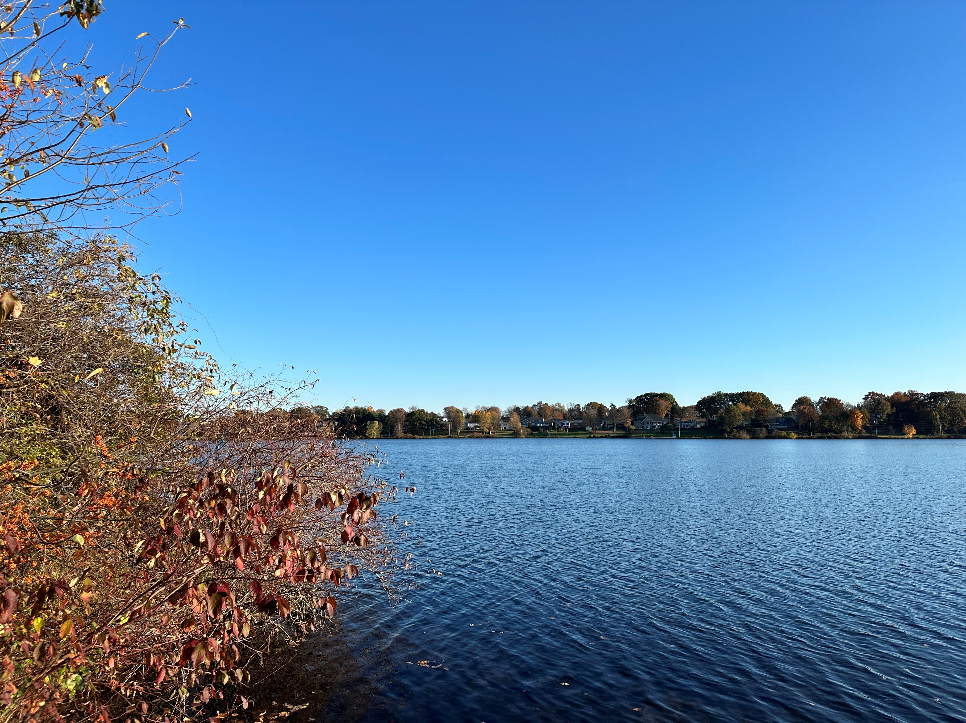
Brief recap:
State DEEP completed a study of Batterson Park in early 2024 which ultimately recommended that the city-owned park be managed through a public-private partnership.
The State Legislature passed a bill in May 2024 that included language that enables State DEEP to enter into an MOU with the City of Hartford and Riverfront Recapture for the management of Batterson Park.
The legislation increases the Passport to Parks fund and allows for dollars from this fund to cover the maintenance of a restored Batterson Park.

Slide 6
Since May of 2024:
The City has worked closely with their construction manager, landscape architect and Riverfront to revise the park design. (Riverfront is a paid subconsultant to CSG.)
Weekly project meetings have been held with the goal of opening a renovated Batterson Park in early Fall 2025.
Riverfront has offered advice on park design that will allow for efficient maintenance, public safety and operations.
Riverfront has also provided counsel on what programs, events and activities could take place in the new park.

Slide 7
In September of 2024, Riverfront’s Batterson Park Subcommittee made the following recommendation to the Executive Committee:
The Batterson Park Subcommittee recommends to the Executive Committee that the organization continue to pursue the Batterson Park management opportunity and engage City and State officials in negotiating a draft memorandum of understanding.

Slide 8
Riverfront’s Executive Committee accepted the recommendation of this subcommittee at their September 2024 meeting.

Slide 9
Within the last couple of months:
The City has received all of the required approvals State and municipal approvals to move the project forward.
The City has engaged Millenium Builders through CRCOG’s EZIQC program.
Construction documents have been finalized.
Other state and federal approvals have been applied for and received.
A revised design was completed by the project team.

Slide 10
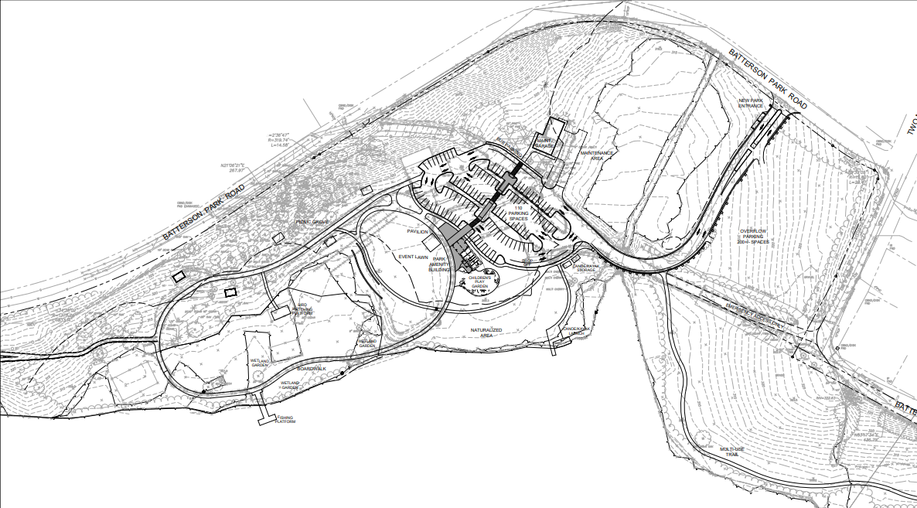

Slide 11
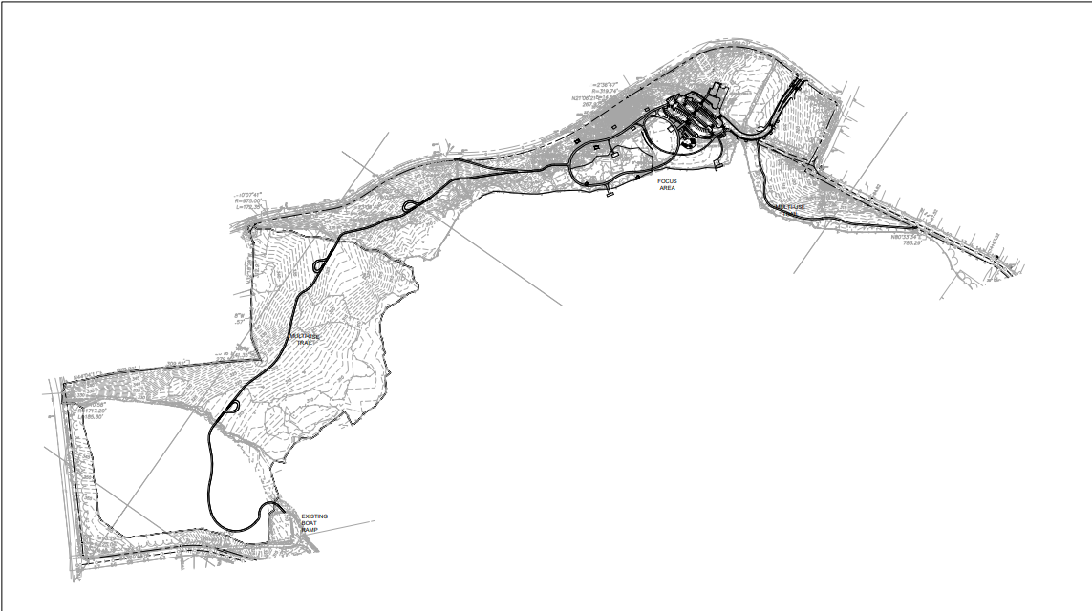

Slide 12
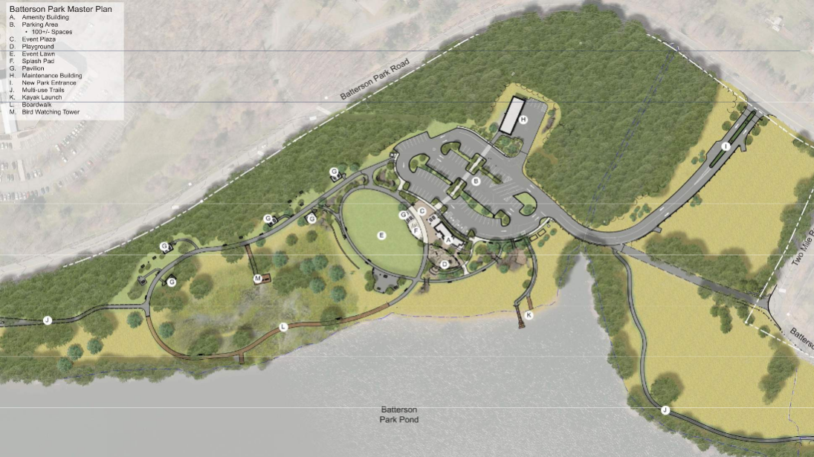

Slide 13
The revised design includes:
Amenities building with public restrooms
Event lawn
At grade and elevated multi-use trails
Multiple pavilions
Playground and splash pad
Bird watching tower
New park entrance
Paved parking for 100+ vehicles
Canoe and kayak launch
Maintenance building with 4 garage bays

Slide 14
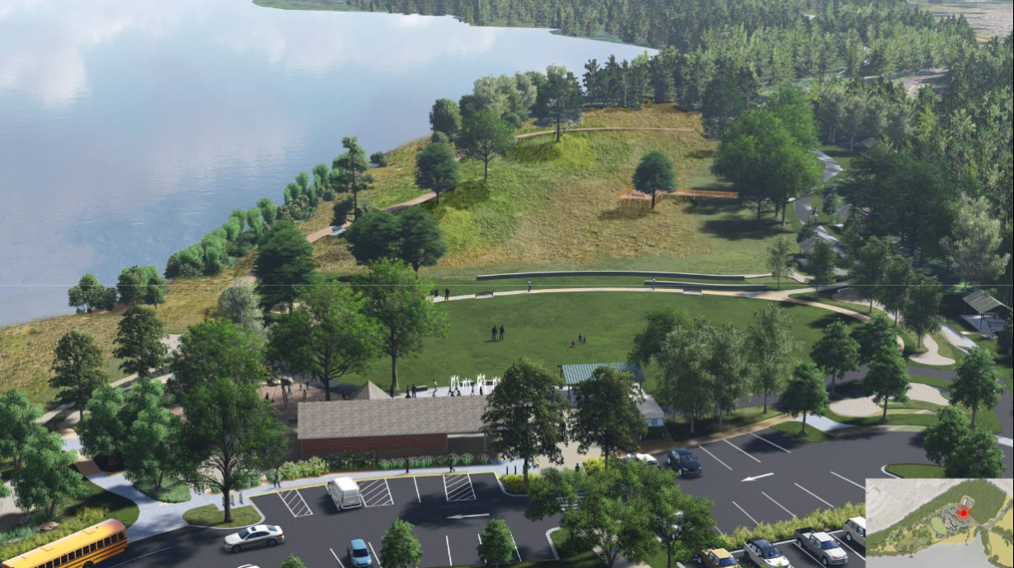

Slide 15
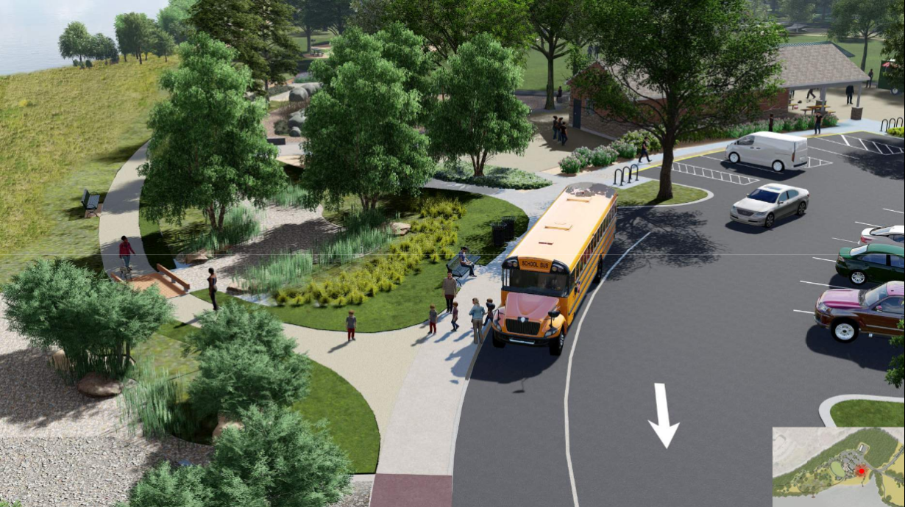

Slide 16
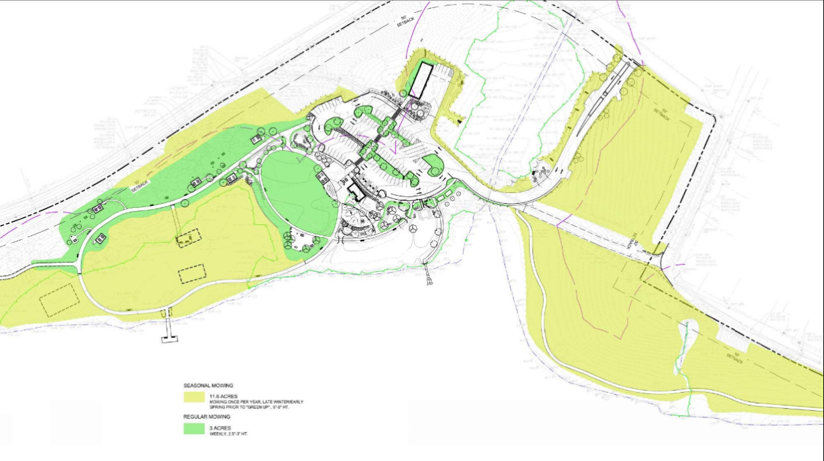

Slide 17
An independent construction estimate was sought.
Both the independent estimate and the contractor’s estimate came in well over in the City’s construction budget of $6,500,000.

Slide 18
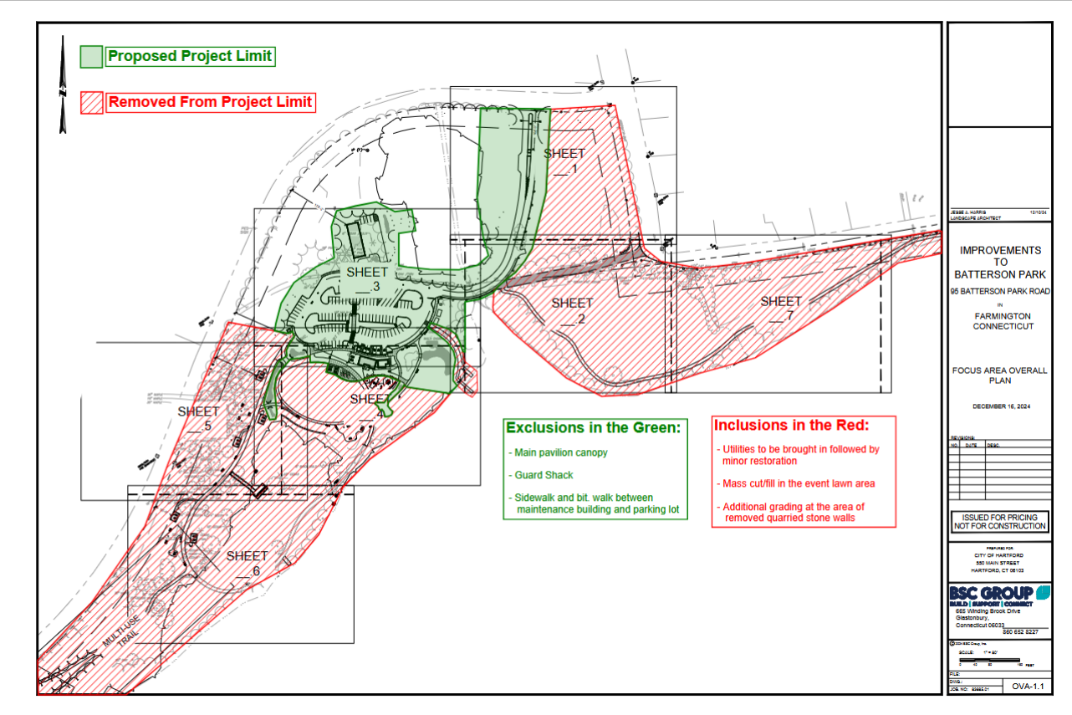

Slide 19

Riverfront Recapture worked with contractor to prioritize critical individual elements, refine the approach and decrease costs where possible.
The City of Hartford redirected $1,000,000 in recreation park lighting and electric grant funds to the Batterson project bringing the construction budget up to $7,500,000.

Slide 20
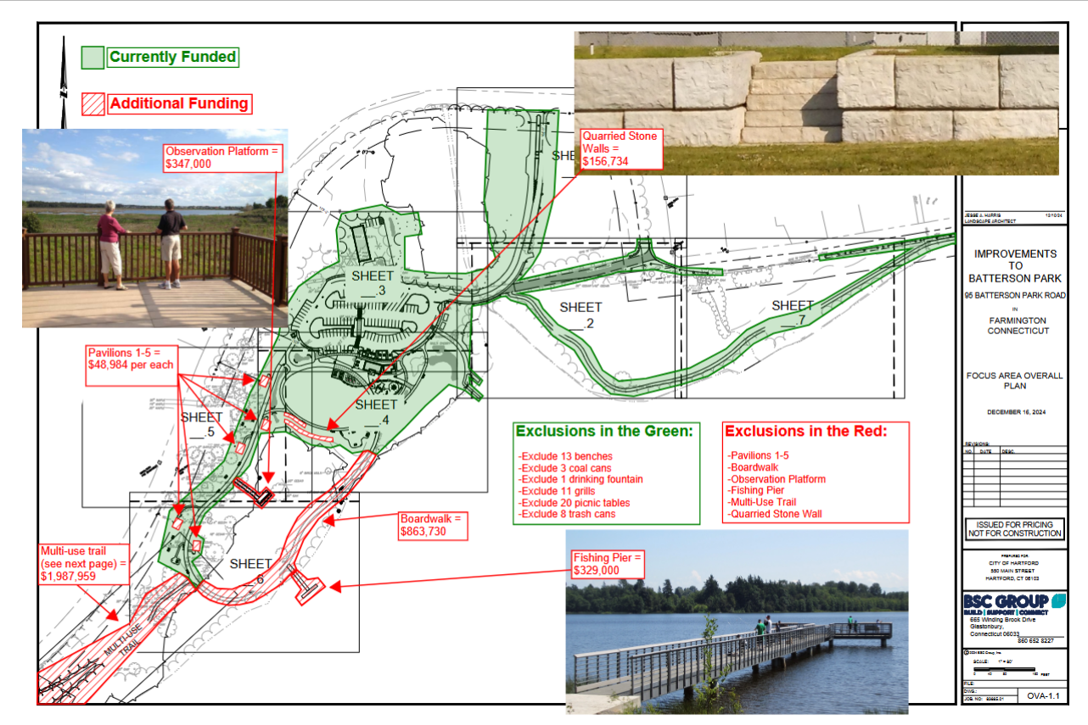

Slide 21
Next steps for project:
City of Hartford is working on a purchase order for roughly $7,500,00 that will allow for contractor to begin work soon.
Pre-construction meeting could take place as early as third week of March.
Meetings to discuss proposed MOU/funding agreement between State DEEP and Riverfront Recapture proposed for third week of March.
City of Hartford meeting with Riverfront on March 4th at 4:00 p.m. to discuss potential park management contract between City and Riverfront Recapture.

Slide 22
Next steps for Subcommittee:
Staff will report back on results from State DEEP and City of Hartford discussions to subcommittee within next couple of weeks.
Subcommittee will reconvene in April to consider proposal.
Subcommittee decides to make a recommendation to proceed or not proceed to full Board.

Slide 23
This subcommittee makes a recommendation to the Executive Committee and full Riverfront Recapture Board to pursue a park management contract with the City of Hartford for Batterson Park.
  or
This subcommittee does not recommend that the organization take on the management of Batterson Park. This would be communicated to the Executive Committee and the organization would notify City of Hartford, State DEEP and Speaker Matt Ritter, among others.

Slide 24
If we proceed:
Riverfront would finalize agreements with the City of Hartford and State DEEP for the management of the park. The agreement with State DEEP would include a budget for the operations and maintenance of the park. This budget would include an administrative fee and park management fee.
Riverfront would work with the City to use a portion of State bond funds to purchase a dump truck, a Bobcat Toolcat, a Ranger truck and other equipment and vehicles needed to operate the new park.
Riverfront would commence with the process to hire appropriate staff to manage the new park space.

Slide 25
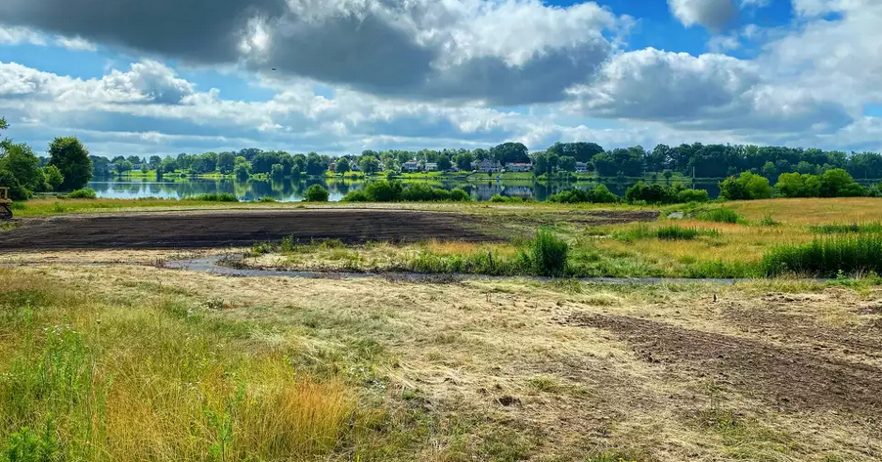

Slide 26
Why do this?
Generate new annual revenue for the Riverfront budget
  Riverfront, like many non-profit organizations, is in need of new revenue sources. We have pursued other social enterprise initiatives with the goal of increasing earned revenue. This has the potential to be a lucrative management contract.
The organization is good at waterfront park management
  We have been responsible for maintenance of our existing Riverfront parks since 2017 and have proven to be capable park managers. Batterson Park is a very good opportunity.

Slide 27
It will be a brand new park
  One of the big challenges of maintaining our existing parks is the wear and tear of 20+ years of park use. Batterson Park will be new and we are currently making recommendations to park designers that will make park maintenance more efficient, cost effective and safe. These enhancements include a state of the art maintenance building and the latest technology for building doors and park gates.
Swimming and the loop trail have been eliminated from the short term discussion
  The two hot button issues have been shelved and we don’t believe either issue will come back any time soon. Riverfront has no experience with swimming or lifeguards and would not be interested in pursuing this contract if swimming was anticipated. The loop trail is not included in draft design and no part of the project touches New Britain or any New Britain property owner.

Slide 28
Strengthened partnership with the City of Hartford
  The City of Hartford, our long-time management partner, has struggled to get this park reopened. It does not have the capacity to take on this responsibility and is in need of a reliable partner. We have already made significant contributions to the park project by providing our experience and expertise.
Strengthened partnership with the State DEEP
  An enhanced relationship with State DEEP, an entity with which we have had multiple challenging interactions, would not hurt. They reached out to us as they know Riverfront as a reputable non-profit and capable park manager. The 2024 DEEP study recommended a public/private partnership. I believe we are one of a few organizations in Connecticut that is capable of undertaking this contract.

Slide 29
The City of Hartford, as the property owner, has committed to shoulder any insurance liability for the park.
  Unlike our existing parks, the City has committed to retaining insurance responsibility for Batterson Park. Riverfront will, of course, maintain our own liability insurance but those costs will be included in the annual park maintenance budget.
Reputation within the greater Hartford community
  Riverfront Recapture was envisioned as a regional organization when it was created in1981. While the founders probably did not envision the management of a park in Farmington, Batterson Park is a very good opportunity to get positive exposure in a part of suburban Hartford that we may not have as much visibility.

Slide 30
Redundancy in Riverfront fleet
  State funding will purchase a brand new fleet of trucks and equipment to manage the park. New fleet will include trucks for the Rangers and operations, Bobcat Toolcat, UTV, mowers, and other equipment necessary for this management project. These will all be purchased new and immediately double our capacity. Vehicles and equipment will have the Riverfront logo and be available for use, if needed, in the existing Riverfront parks.
Redundancy in personnel
  Staff assigned to Batterson Park will be trained to work in the Riverfront parks, as well. Batterson personnel can be pulled to assist with flood clean-up and other urgent projects in the existing Riverfront parks.

Slide 31
Reopening Batterson Park is a priority for Speaker Matt Ritter.
  Reopening this Hartford park is a top priority for the Speaker. We will need the Speaker’s support for our future park in Hartford / Windsor. Speaker Ritter is a long-time friend of the organization and genuinely appreciates Riverfront’s willingness to be part of a solution.
Passport to Parks is a popular and stable funding source
  Park maintenance and operations will be fully funded by the State of Connecticut through the Passport to Park program, a relatively stable funding source. We will request a multi-year commitment. State DEEP believes the program is fully funded through 2030 with the increase approved during the 2024 legislative session.

Slide 32
Revisting logical concerns:
Managing Batterson Park is outside of Riverfront’s mission to connect people with the Connecticut River
Staff is already beyond capacity with existing parks, RLI and Riverwalk project
Jurisdictional challenges of a Hartford park in Farmington and New Britain
Batterson Park has been contentious for years and these three municipalities haven’t really gotten along

Slide 33
Managing Batterson Park is outside of Riverfront’s mission to connect people with the Connecticut River
Riverfront Recapture is very good at managing waterfront parks. In order to continue our work managing the four existing Riverfront parks and prepare for the addition of a new park in Hartford / Windsor, we need to find new sources of revenue.
Our mission can evolve. In fact, our auditors have stated that should the organization decide to take on this park management responsibility, the mission will have to change to avoid Unrelated Business Interest Tax (UBIT).

Slide 34
2. Staff is already beyond capacity with existing parks, RLI and Riverwalk project
Operation staff do indeed have their hands full with our existing parks system. And the new park and Riverwalk will require additional effort.
I am confident that we will be able to ramp up our park management and public safety capacity to meet this new challenge.
This new contract will provide more than enough annual funding to bring on the staff necessary to manage the new park. These staff members would be available to assist in the existing parks, when needed.
In addition, a new park management contract will allow for the purchase of all of the equipment necessary to properly manage the new park. This equipment would be available for use in the existing parks system, when needed.

Slide 35
3. Jurisdictional challenges of a Hartford park in Farmington and New Britain
I believe that municipal and state officials are committed to working through all of the jurisdictional challenges in advance of the signing of any MOU that would codify Riverfront’s involvement in a management contract.
Riverfront should require that Farmington and New Britain officials commit to providing municipal services where appropriate to allow for smooth operation of the new park.

Slide 36
4. This Batterson Park thing has been contentious for years and these three municipalities haven’t really gotten along
Riverfront Recapture already has the trust and respect of the City of Hartford as a long-time management partner. Riverfront has the opportunity to provide professional park management services and earn the trust and respect of Farmington and New Britain.
Our reputation proceeds us. I have had many positive conversations with municipal and state officials from each town. They believe that Riverfront Recapture is uniquely positioned to bring some stability to this project.
Everyone seems to be ‘committed to a solution’.

